Slide 1

Group 2 Insurance Cost Prediction
YENIMETLA VENKATA Krishna chaitanya
Rahul r
YANDRAPU ANDREA CHAMIlI VARSHA

Slide 2
AGENDA
Objective
Dataset Description
Descriptive Analysis
Handling Missing Values
Data Analysis
Modelling Techniques
Features Importance
Conclusion

Slide 3
OBJECTIVE
Our main objective is some factors that affect how much health insurance premiums cost.
The basics of the linear regression model and applied it to predict charges and seen the correlation between predicted and actual results.
Random Forest Regression provides higher accuracy through cross validation. Random forest classifier will handle the missing values and maintain the accuracy of a large proportion of data.
Correlation and Mutual information between single variables and the target are often used as Ranking-Criteria of variables(features importance)

Slide 4
DATASET DESCRIPTION
This Insurance dataset consists of 1338 rows and 7 columns.
age: age of primary beneficiary
sex: insurance contractor gender, female, male
bmi: Body mass index, providing an understanding of body, weights that are relatively high or low relative to height, objective index of body weight (kg / m ^ 2) using the ratio of height to weight, ideally 18.5 to 24.9
children: Number of children covered by health insurance / Number of dependents
smoker: Smoking
region: the beneficiary's residential area in the US, northeast, southeast, southwest, northwest.
charges: Individual medical costs billed by health insurance(target – y)

Slide 5
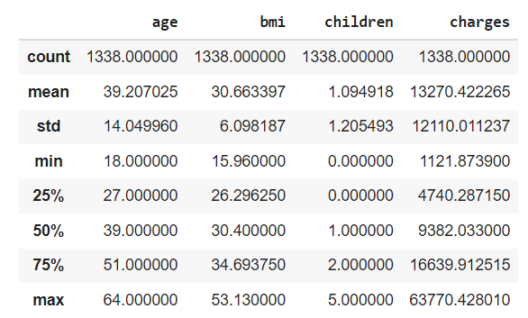
DESCRIPTIVE ANALYSIS
Overview of the dataset

Slide 6
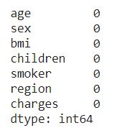
HANDLING MISSING VALUES
No missing values in the dataset.

Slide 7
DATA ANALYSIS
EDA
Barplot
Lmplot
Violinplot
Heatmap
Scatterplot

Slide 8
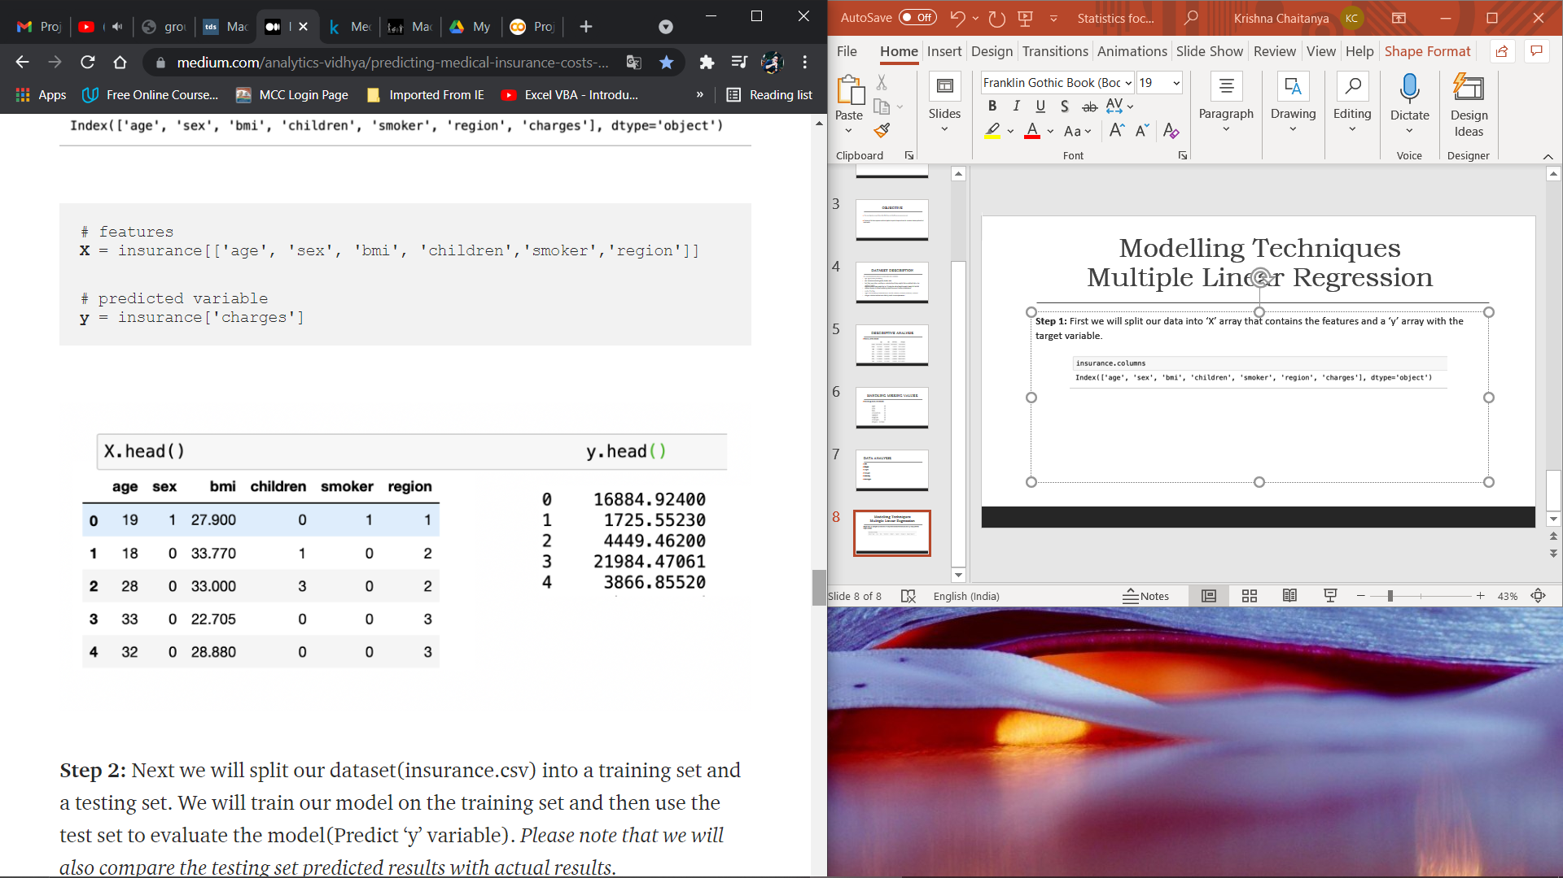
Modelling Techniques Multiple Linear Regression
Step 1: First we will split our data into ‘X’ array that contains the features and a ‘y’ array with the target variable.

Slide 9
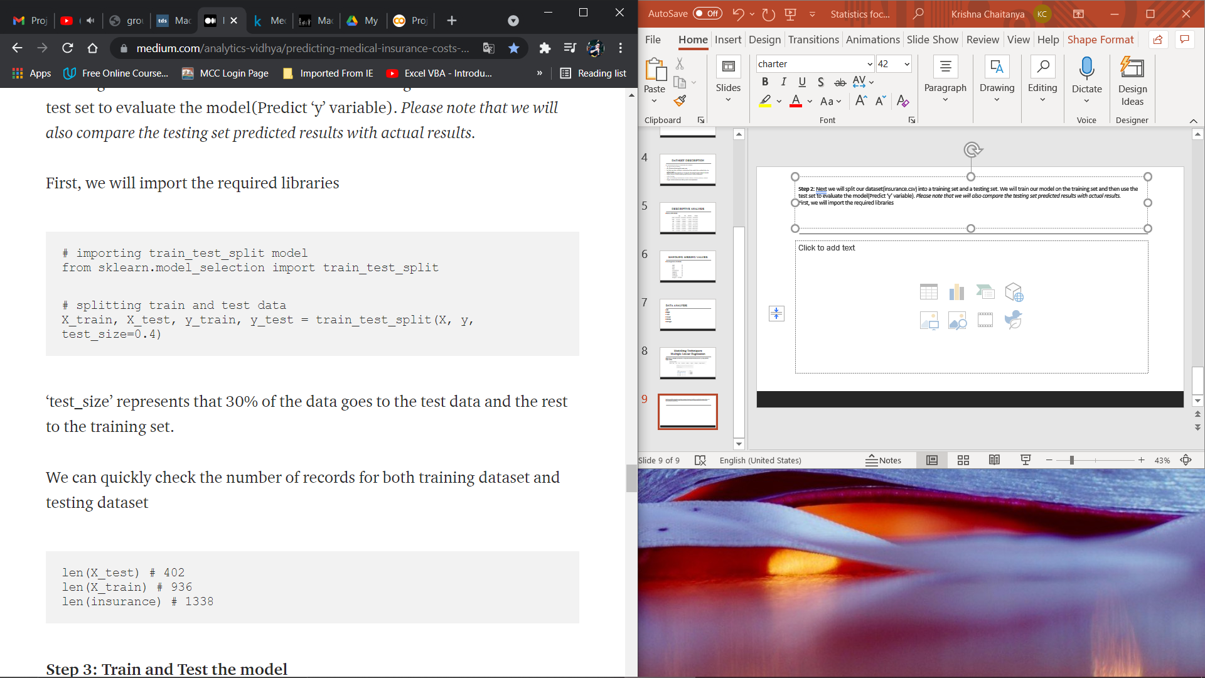
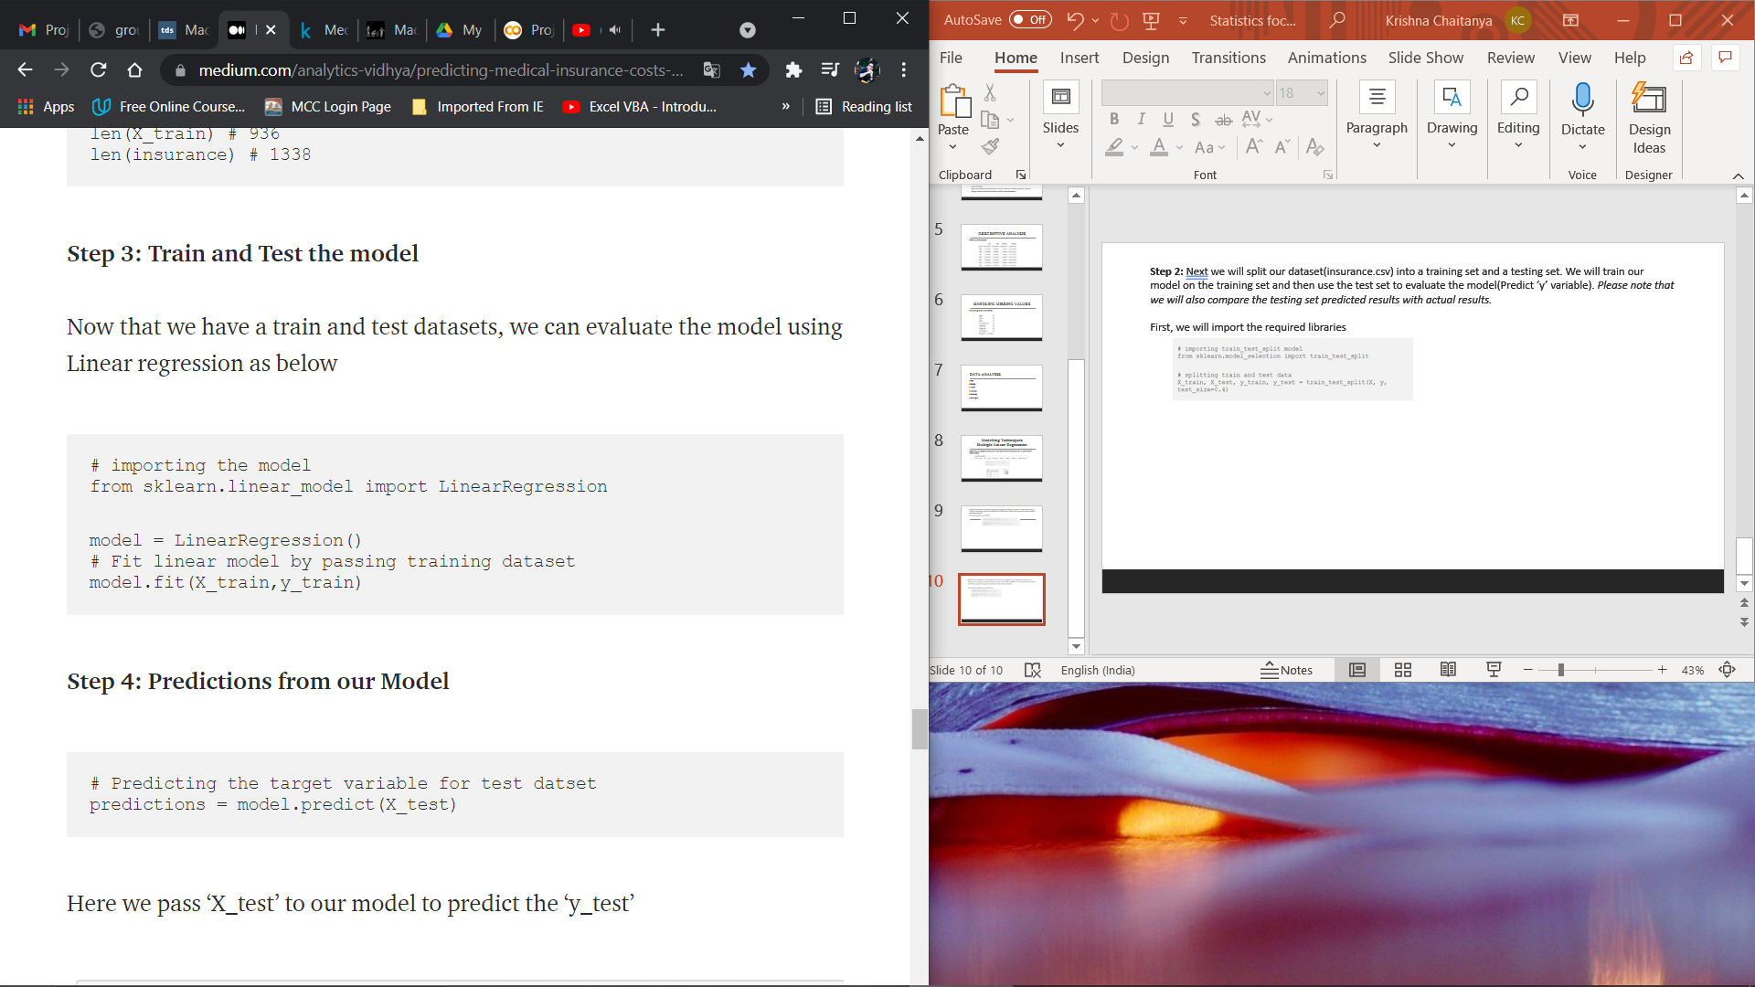
Step 2: Next we will split our dataset(insurance.csv) into a training set and a testing set. We will train our model on the training set and then use the test set to evaluate the model(Predict ‘y’ variable). Please note that we will also compare the testing set predicted results with actual results.
First, we will import the required libraries
Step 3: Train and Test the model
Now that we have a train and test datasets, we can evaluate the model using Linear regression as below

Slide 10
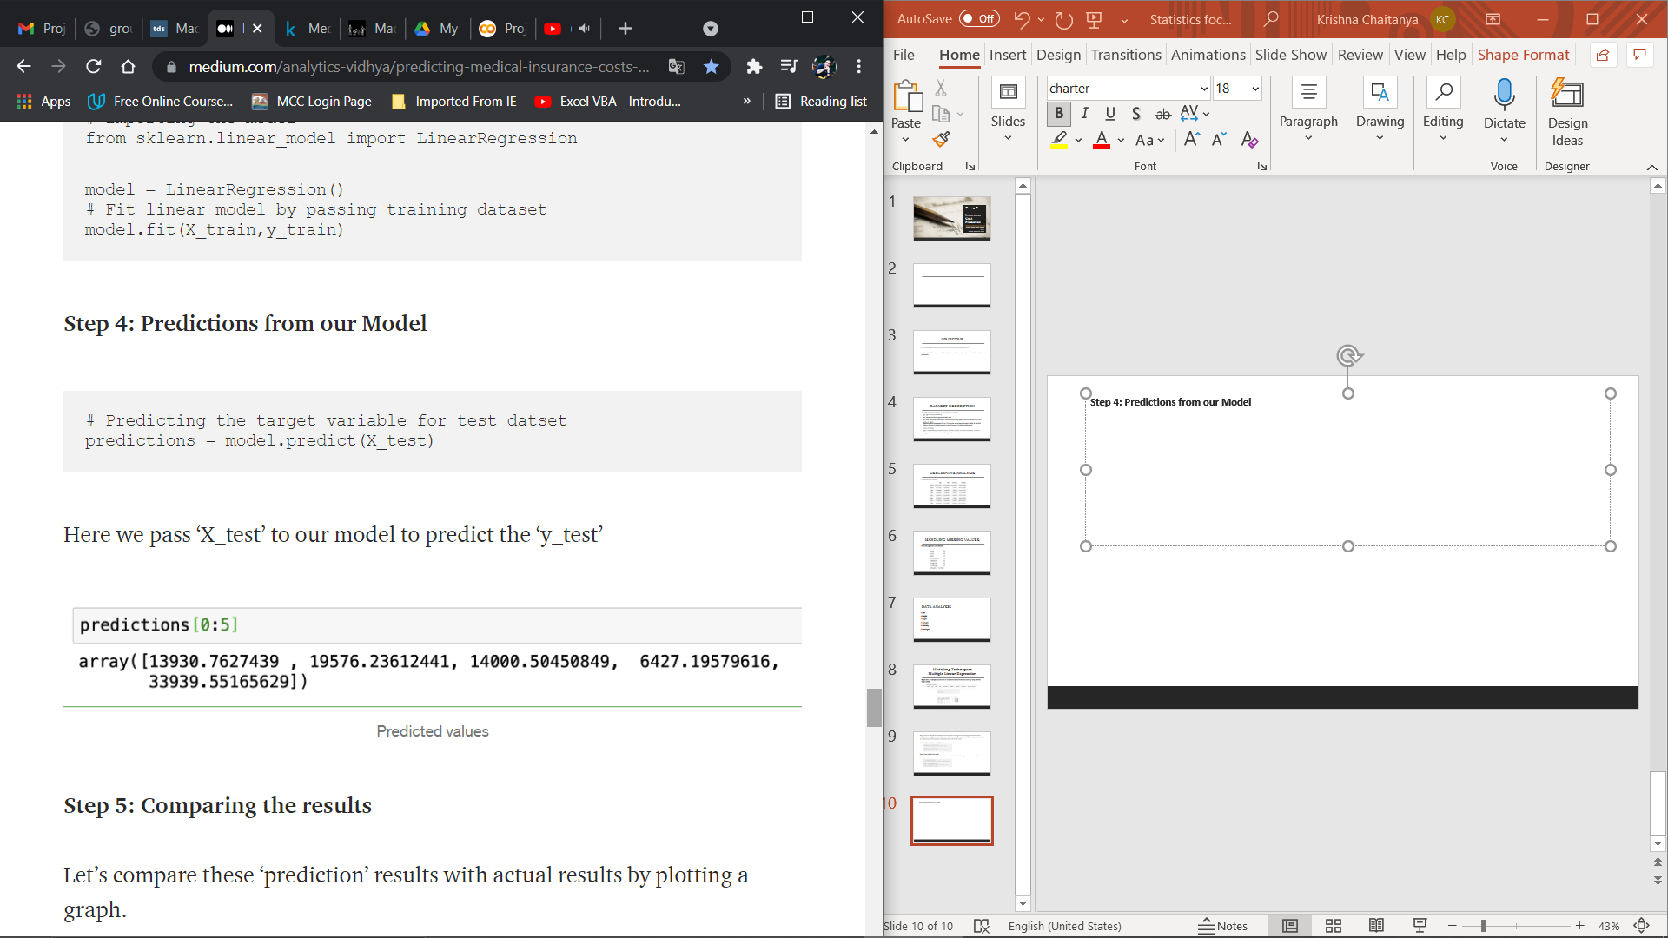
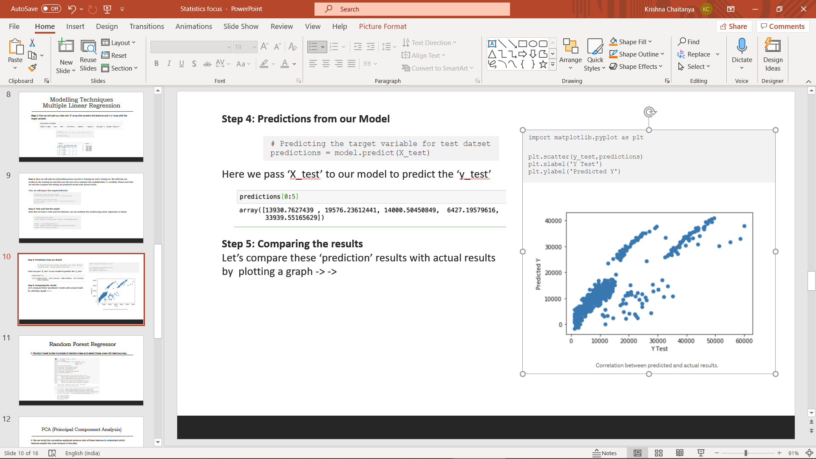
Step 4: Predictions from our Model
Here we pass ‘X_test’ to our model to predict the ‘y_test’
Step 5: Comparing the results
Let’s compare these ‘prediction’ results with actual results
by plotting a graph

Slide 11
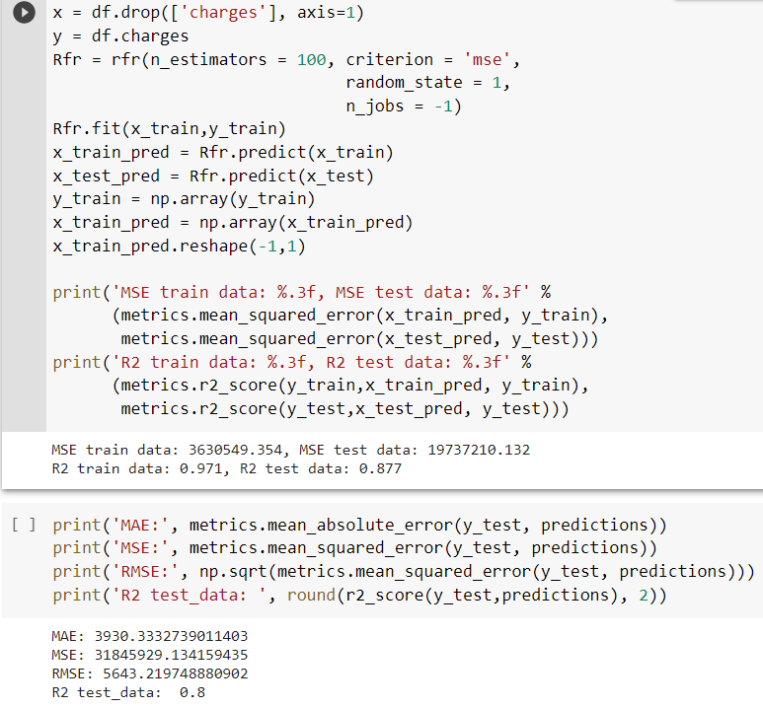
Random Forest Regressor
Random forest builds hundreds of decision tress and select those ones with best accuracy.

Slide 12
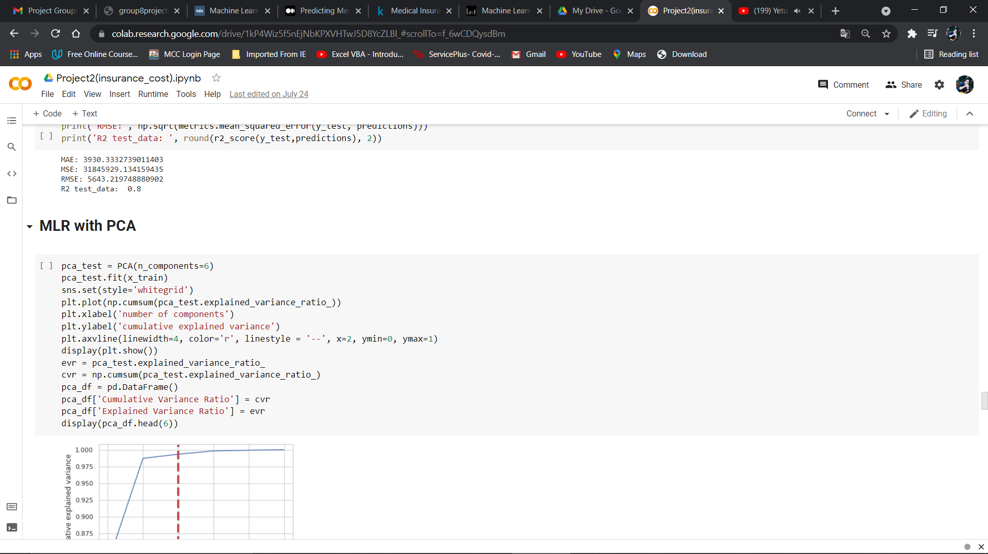
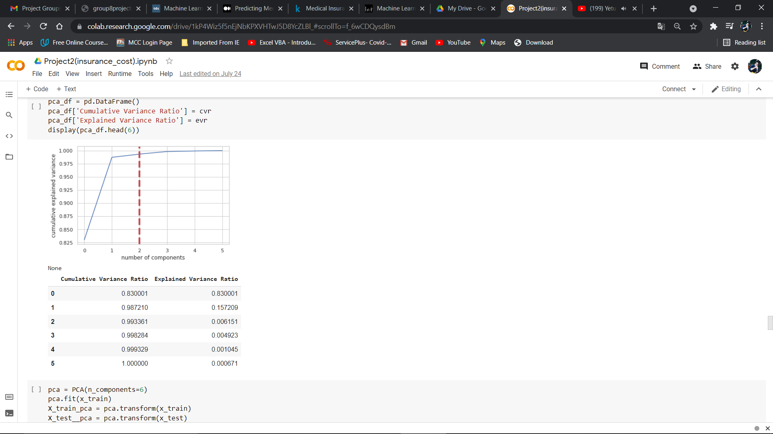
PCA (Principal Component Analysis)
We can study the cumulative explained variance ratio of these features to understand which features explain the most variance in the data.

Slide 13
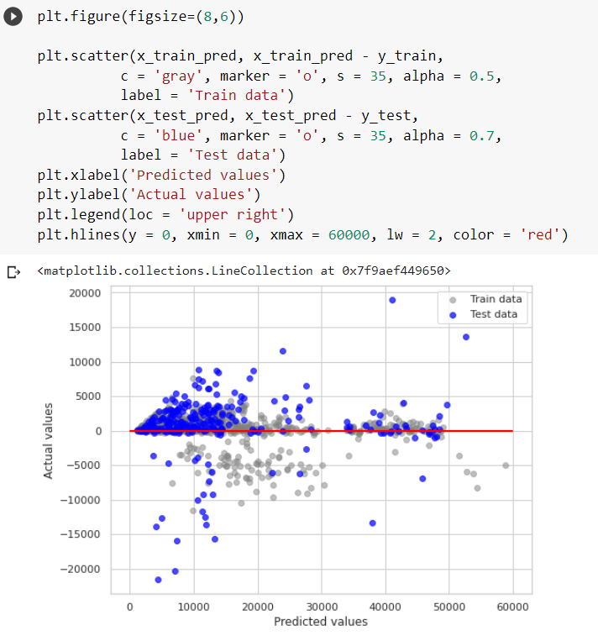
MLR AND RFR WITH PCA

Slide 14
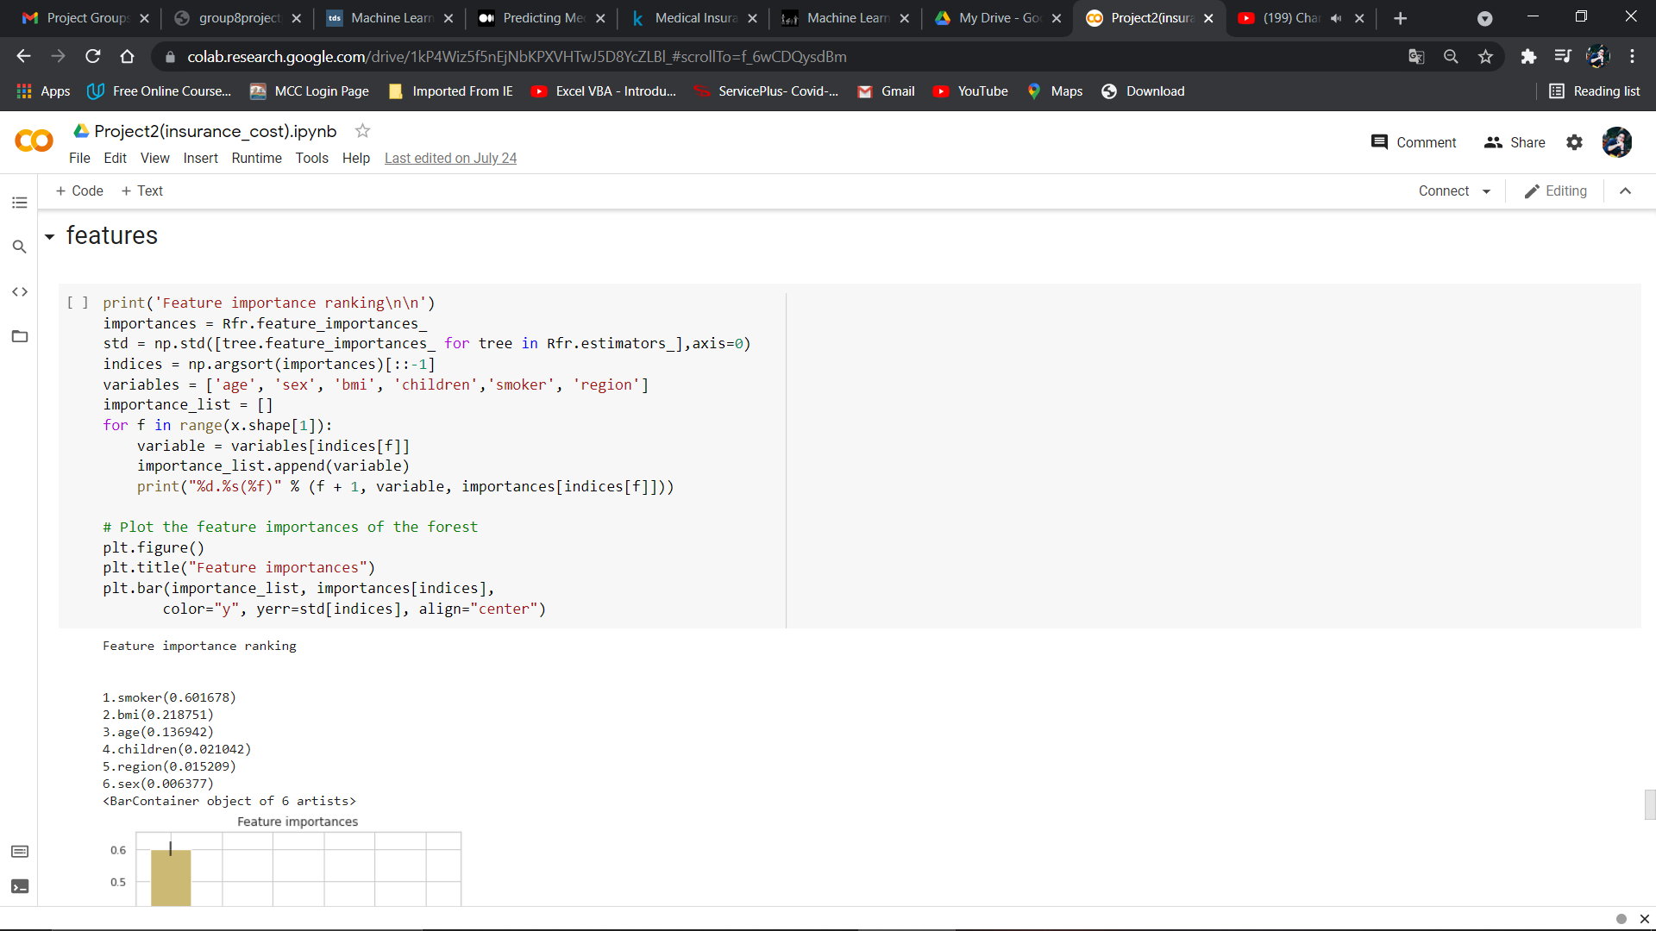
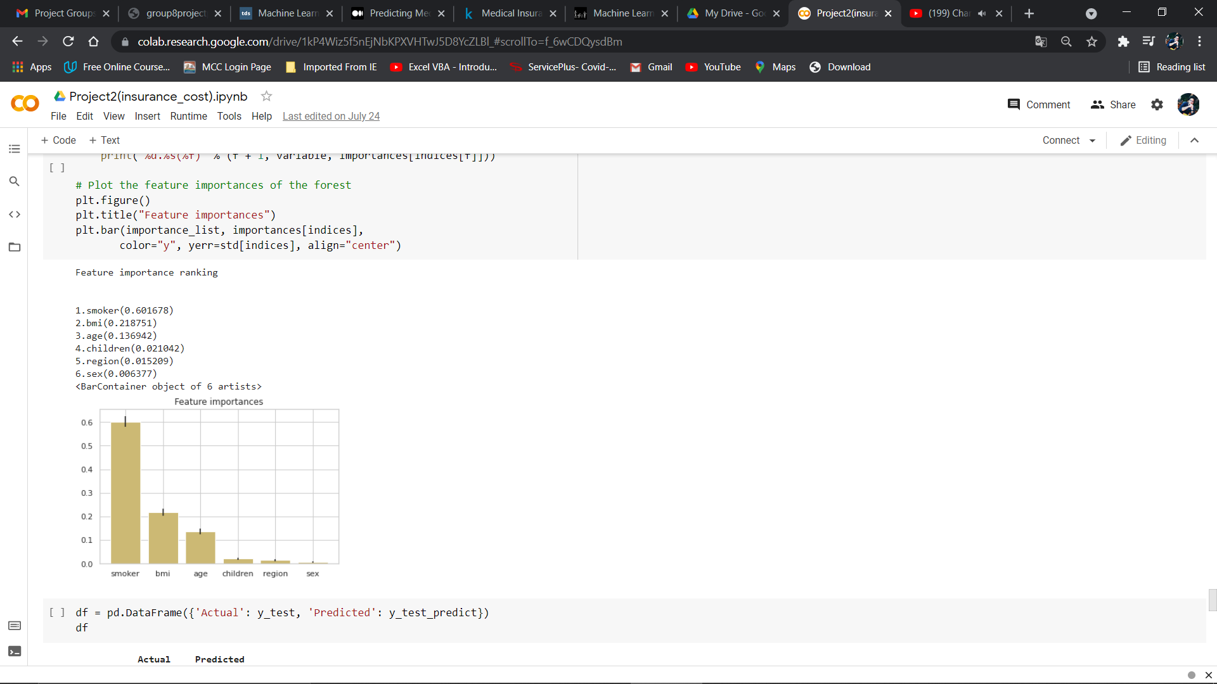
FEATURES IMPORTANCE
Feature importance scores play an important role in a predictive

Slide 15
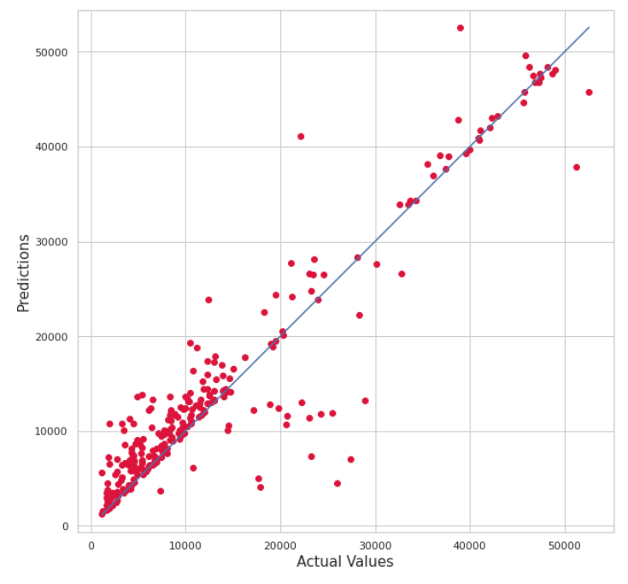
CONCLUSION
Smoking is the greatest factor that affects medical cost charges, then it's bmi and age.
The best approach to the Random Forest Regressor model with an MAE value of 3930.33, RMSE value of 5643.21and R -squared value of 0.8.
Result

Slide 16
THANK YOU

